Slide 1
Smart-Gas Pte Ltd
140 Paya Lebar Road #05-21, AZ Building, Singapore 409015
Tel : (65) 6848 1040 / Fax : (65) 6848 2173
IGEU 8899861 - General Identity & Weights
Tank Number | IGEU 8899861
Manufacturer | Global
Date of Mfg | 10-Nov-2025
Lease | No
UN ISO Code | T11
Size | 12'
Tare Weight | 12,000 kg
Gross Weight | 4,850 kg
Net Weight | 4,500 kg
Max Gross Weight | 11,111 kg
Max Payload | 12,346 kg

Slide 2
Smart-Gas Pte Ltd
140 Paya Lebar Road #05-21, AZ Building, Singapore 409015
Tel : (65) 6848 1040 / Fax : (65) 6848 2173
IGEU 8899861 - Technical Specifications
Capacity | 25,000 L
MAWP | 112 Bar
Working Pressure | 100 Bar
Design Temp | -196°C to 50°C
Vessel Material | Carbon Steel SA-516 Gr. 71
PV Code | GB150 / IMDF

Slide 3
Smart-Gas Pte Ltd
140 Paya Lebar Road #05-21, AZ Building, Singapore 409015
Tel : (65) 6848 1040 / Fax : (65) 6848 2173
IGEU 8899861 - Construction Details
Frame Type | normal
Cabinet Type | yes
Color | Orange
Pump Type | Nil
Remarks | Outlet valve requires inspection during next service. Fitted with pressure relief device P RD-456

Slide 4
Smart-Gas Pte Ltd
140 Paya Lebar Road #05-21, AZ Building, Singapore 409015
Tel : (65) 6848 1040 / Fax : (65) 6848 2173
IGEU 8899861 - Regulations
Regulation | Approval No | IMO Type | Safety Std | Country
TIR | AP-2025-002 | IMO-T12 | EN 1445 | US
ADR | AP-2025-005 | IMO-T11 | EN 1444 | IND

Slide 5
Smart-Gas Pte Ltd
140 Paya Lebar Road #05-21, AZ Building, Singapore 409015
Tel : (65) 6848 1040 / Fax : (65) 6848 2173
IGEU 8899861 - Approved Cargos
Cargo Name | Density | Parts | Compat Notes
Liquid Hydrogen | 1.1kg/m^3 | valve | teflon

Slide 6
Smart-Gas Pte Ltd
140 Paya Lebar Road #05-21, AZ Building, Singapore 409015
Tel : (65) 6848 1040 / Fax : (65) 6848 2173
IGEU 8899861 - Certificates
Cert Number | Agency | Insp Date | Next Due
999 | DNV | 26-Nov-2025 | 30-Nov-2025

Slide 7
Smart-Gas Pte Ltd
140 Paya Lebar Road #05-21, AZ Building, Singapore 409015
Tel : (65) 6848 1040 / Fax : (65) 6848 2173
IGEU 8899861 - Technical Drawings
Type | Filename | Description
P&ID (Piping & Instrumentation Diagram) | Picsart_25-11-13_21-58-33-255.jpg | P and ID

Slide 8
Smart-Gas Pte Ltd
140 Paya Lebar Road #05-21, AZ Building, Singapore 409015
Tel : (65) 6848 1040 / Fax : (65) 6848 2173
IGEU 8899861 - Valve Test Reports
Test Date | Inspected By | Remarks
29-Nov-2025 | luffy | all good

Slide 9
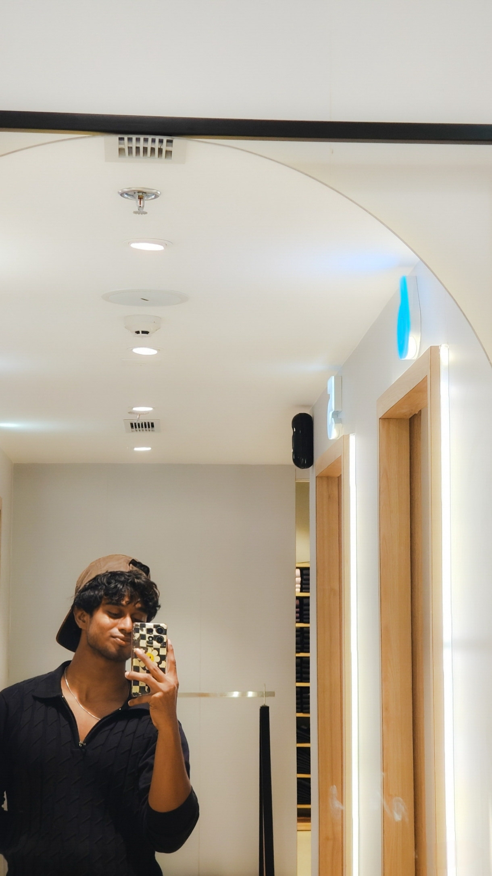
Smart-Gas Pte Ltd
140 Paya Lebar Road #05-21, AZ Building, Singapore 409015
Tel : (65) 6848 1040 / Fax : (65) 6848 2173
IGEU 8899861 - Certificate Copies
Cert: 999

Slide 10
Smart-Gas Pte Ltd
140 Paya Lebar Road #05-21, AZ Building, Singapore 409015
Tel : (65) 6848 1040 / Fax : (65) 6848 2173
IGEU 8899861 - Drawing Documents
Drawing: P&ID (Piping & Instrumentation Diagram)

Slide 11
Smart-Gas Pte Ltd
140 Paya Lebar Road #05-21, AZ Building, Singapore 409015
Tel : (65) 6848 1040 / Fax : (65) 6848 2173
IGEU 8899861 - Valve Test Documents
Report: 29-Nov-2025

